Slide 1





UI / UX
CASE STUDY
TRUSTPOLL
PORTFOLIO
Mentor : Sarankumar Maran
Team Members :
Mohamed Salih M
Suresh V
Premnath A
Hariharan R I
Arun Ulagappan S
Harish G S

Slide 2


Introduction
Trustpoll
2025
TrustPoll is a secure, proxy-proof online voting system built for institutions to conduct fair and verifiable elections. It ensures transparency through clear feedback, role-based interfaces, and strong multi-layer authentication. The platform focuses on simplicity, guiding both admins and voters through a clean, step-by-step election workflow.
WHAT IS
TRUSTPOLL?

Slide 3
Overview
Trustpoll
2025
Problem Statement
Problem Solution
Online elections face fraud, proxy voting, and identity misuse.
Existing systems lack transparency and real-time monitoring.
Users struggle with complex, confusing voting interfaces.
Provide secure, proxy-proof authentication with multi-layer verification.
Enable transparent dashboards and real-time election monitoring.
Deliver simple, guided UI for error-free voting.

Slide 4






Process
Trustpoll
2025
Design Process
Discover
Define
Ideate
Design
Target Audience
User Survery
Competitive analysis
User Persona
Feature Roadmap
Process Flow
Information Architecture
Wireframe
Figma Prototype

Slide 5

Target Audi
Trustpoll
2025
TARGET AUDIENCE
The target audience includes institutional administrators who manage and monitor elections securely. It also serves students and registered voters who need a simple, trustworthy platform to cast their votes without complexity or fraud.

Slide 6
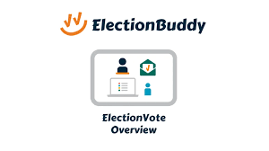


Competitors
Trustpoll
2025
COMPETITORS
b. ElectionBuddy
a. Strawpoll
c. Voatz

Slide 7
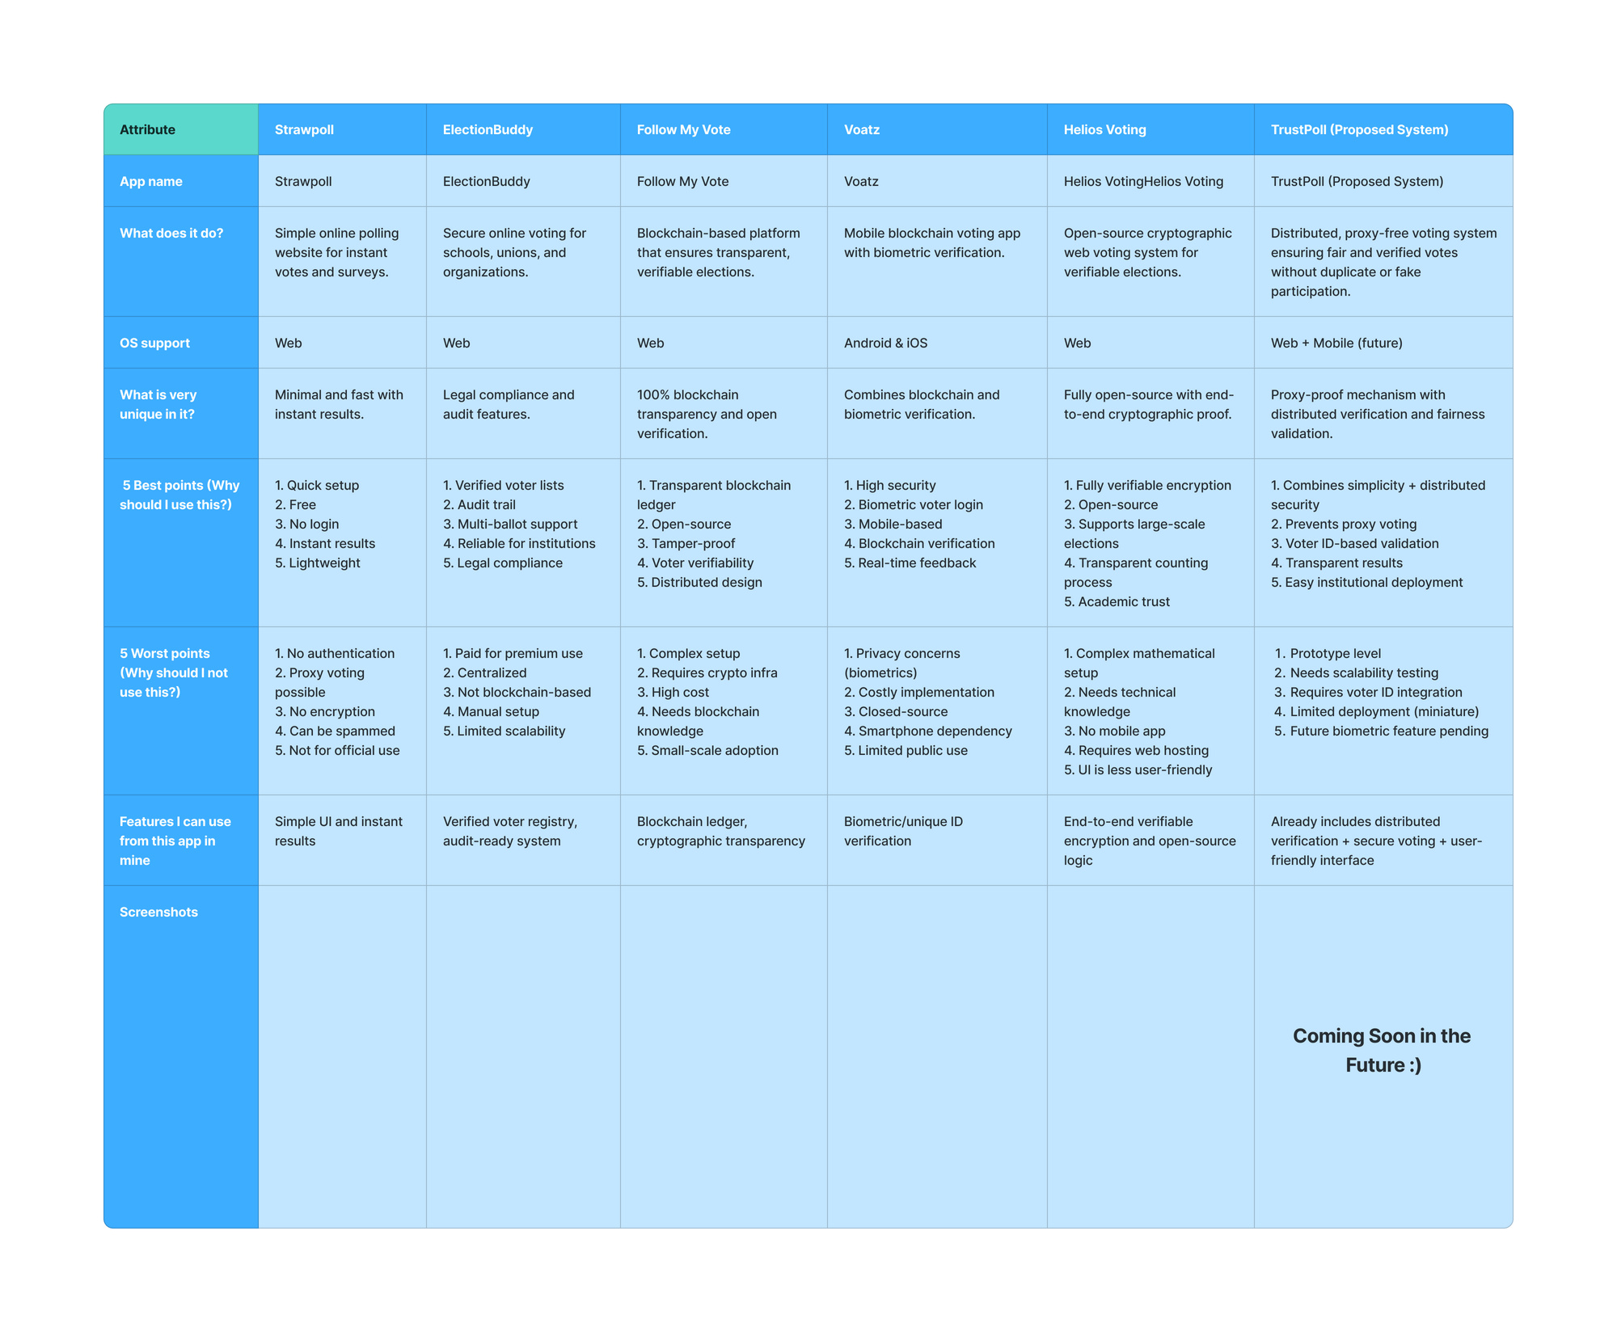
Competitors
Trustpoll
2025
COMPETITIVE ANALYSIS

Slide 8





User Persona
User Interview
User Views &
Pain Points
4
3
20+
Questions
Choices
Participants
Vote Now

Slide 9
Arjun
Education
Income
Mehta
Bachelor’s Degree
Student
Personality
Detail-oriented, cautious, responsible
Digital Behavior
Uses secure tools, checks dashboards frequently
Preferred Devices
Favorite Platforms
laptop first, mobile for quick checks
Google Workspace, Notion
Goals
Run fair elections, avoid technical issues, maintain transparency.
The Election Officer
“If it’s simple and secure, it works for me.”
Pain Points
Hard to monitor voters in real time; messy admin tools.
Age
Occupation
Location
Brand Values
19
Years Old
College Election Administrator
Bengaluru
Trust, security, clarity.

Slide 10

Education
Income
Pursuing B.Tech
Student
Personality
Fast-paced, tech-savvy, hates complicated steps
Digital Behavior
Quick interactions, prefers instant verification
Preferred Devices
Favorite Platforms
Mobile phone
Instagram, Google Pay
Hema
Goals
Reddy
Vote quickly, easily, and without confusion
“I just want to log in and vote without stress.”
Pain Points
The Student Voter
Long signup steps, unclear status messages, login issues
Age
Occupation
Location
Brand Values
20
Years Old
Undergrad
Student
Hyderabad
Simplicity, speed, ease

Slide 11


Sameer
Education
Income
B.Sc. Computer Science
₹ 6–8 LPA
Shah
Personality
Analytical, curious, process-driven
Digital Behavior
Tests systems deeply, values clean structure
Preferred Devices
Favorite Platforms
Desktop, Mobile, Tablet
GitHub, StackOverflow
Goals
Ensure system reliability, audit trails, and data safety.
The Technical Reviewer
Pain Points
“Show me the logic, and I’ll trust the system.”
Poor logs, confusing workflows, unreliable verification steps
Age
Occupation
Location
Brand Values
28
Years Old
IT Support / System Auditor
Pune
Transparency, accuracy, efficiency

Slide 12
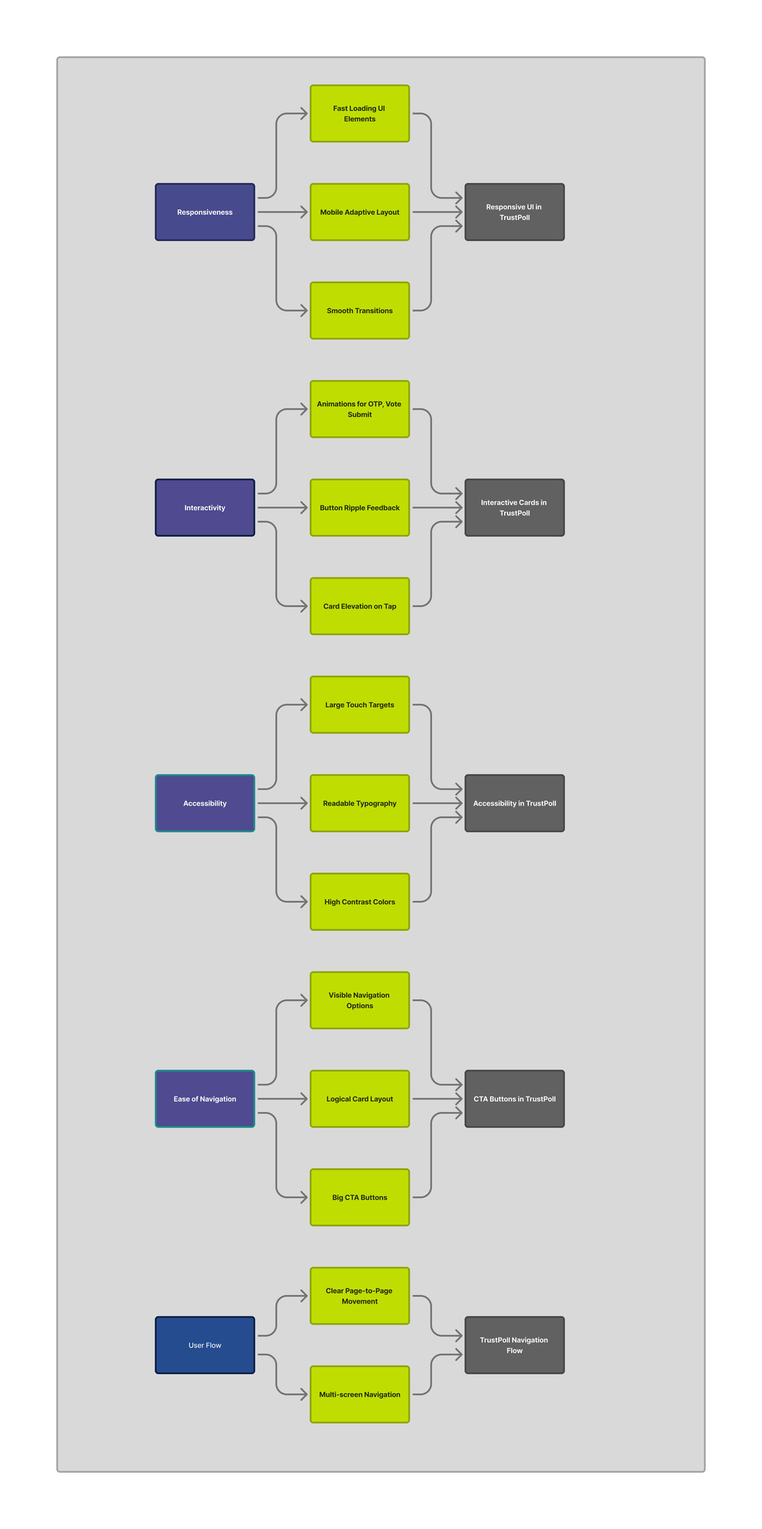
Feature Map
Trustpoll
2025
UX TO FEATURE MAPS

Slide 13
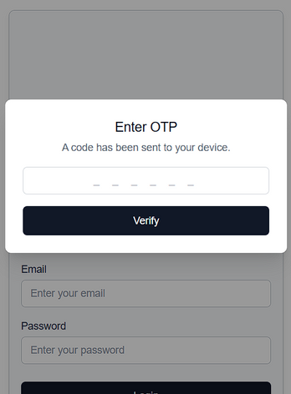
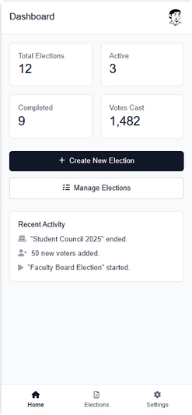
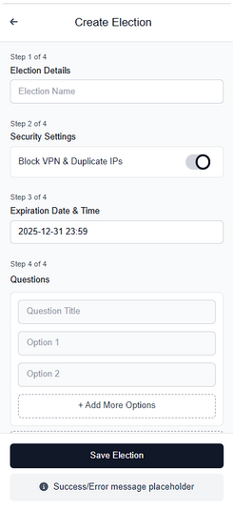
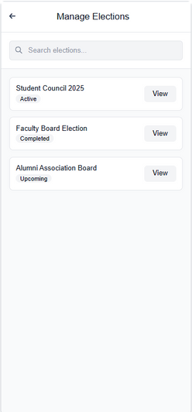
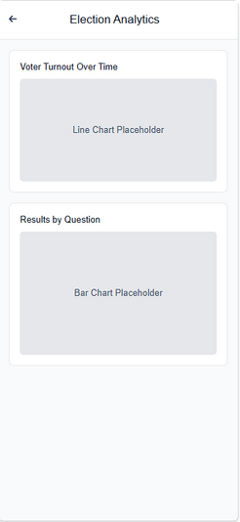
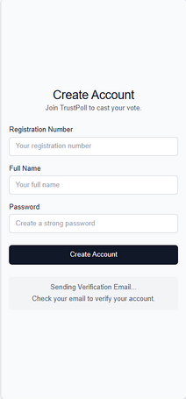
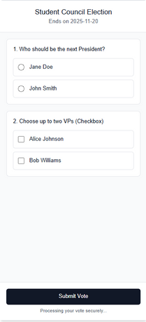
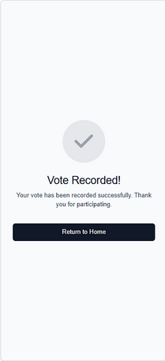
Wireframes
Trustpoll
WIREFRAMES
2025
Admin Flow
Voter Flow

Slide 14
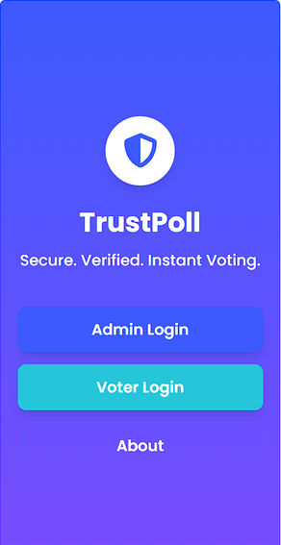
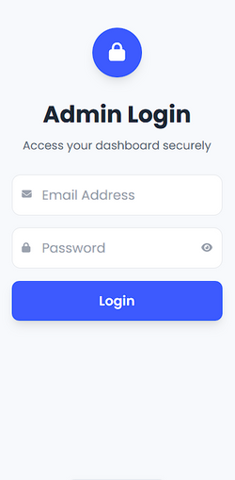
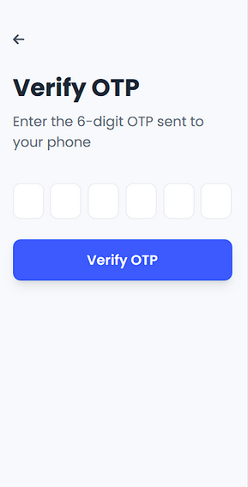
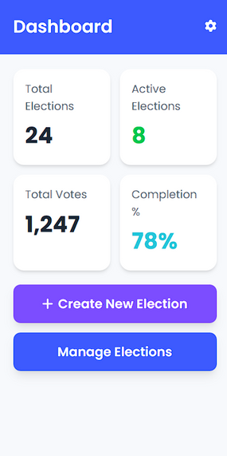
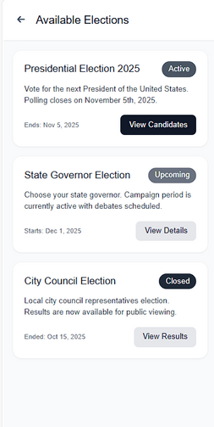
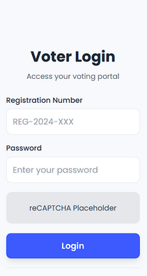
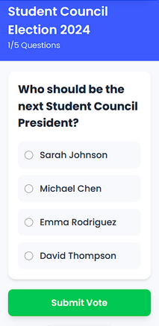
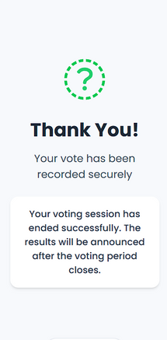
Prototype
Trustpoll
PROTOTYPE
2025
Admin Flow
Voter Flow

Slide 15

Pain Points
Paucek and Lage
2025
PAIN POINTS
1
2
3
Proxy & Identity Vulnerability
Lack of Real-Time Transparency
Complex User Experience
Institutions struggle to prevent proxy voting and identity misuse. A reliable mechanism is needed to ensure each vote is authentic.
Admins have limited visibility into voter activity and election health.
This results in uncertainty and reduces trust in the voting process.
Voters often find digital election interfaces confusing or overwhelming. Complicated steps lead to errors and lower participation rates.

Slide 16



UI/UX
Case Study
THANK YOU
TRUSTPOLL
2025

